Slide 1
Product information
Part Name :- P18_ AUX Cover
Index No :-
Model :-
Plastic material :- HI-PS
Shrinkage :- 1.005
Part Weight :- 23g
Tooling information
Tooling type :- 2PLATE
Hot Runner system :- NONE
Gate type :- SIDE GATE
No. of cavities :- 1 X 4
No. of slider :- NONE
No. of lifters :- NONE
Main insert material :- NAK-80 ( BPM-HHH )
Mold base material :- S50C
Mold base Standard :- LKM
Injection machine capacity :- 75T
RESULT | OK | NG
APPD
DATE

Slide 2
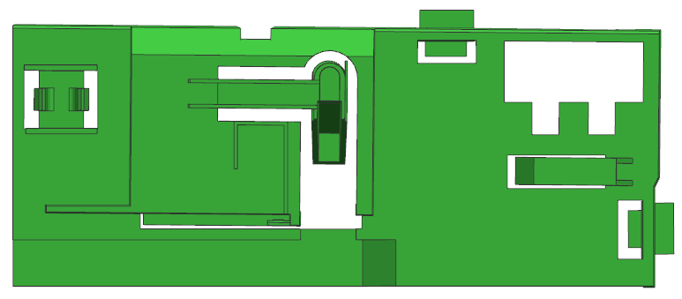
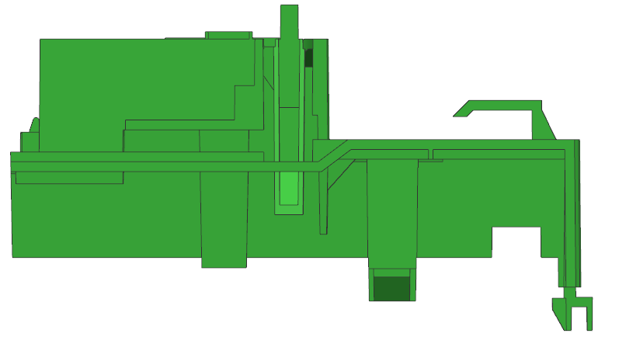
Product size
49.75
118.54
66.36

Slide 3
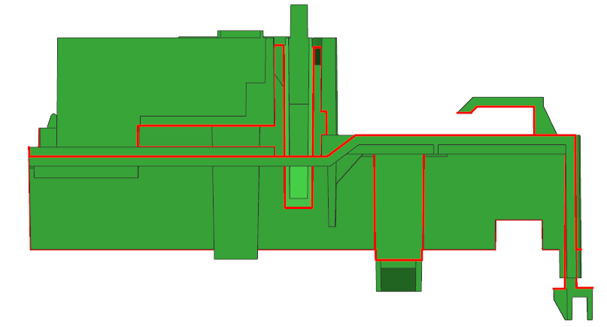
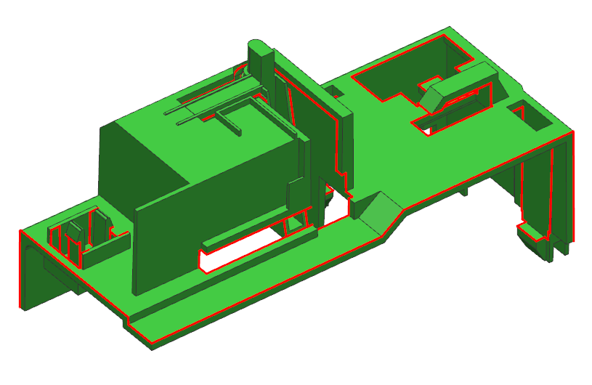
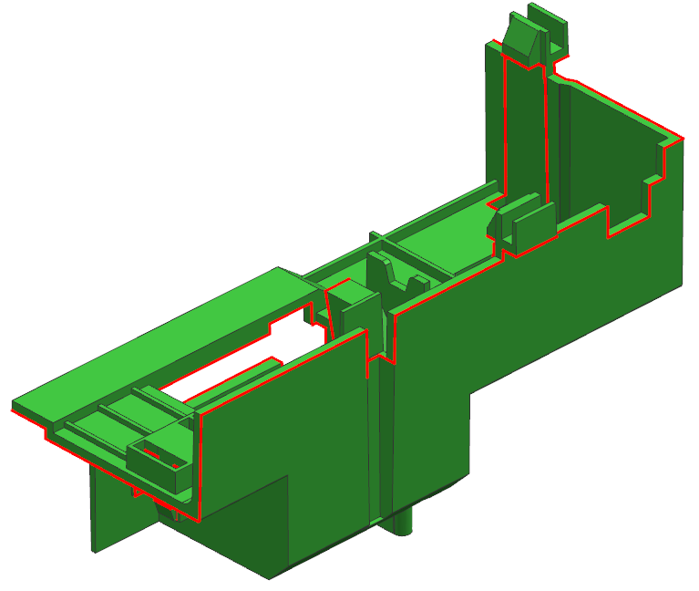
1.Parting Line
CAV
PL
COR
RESULT | OK | NG
APPD
DATE

Slide 4
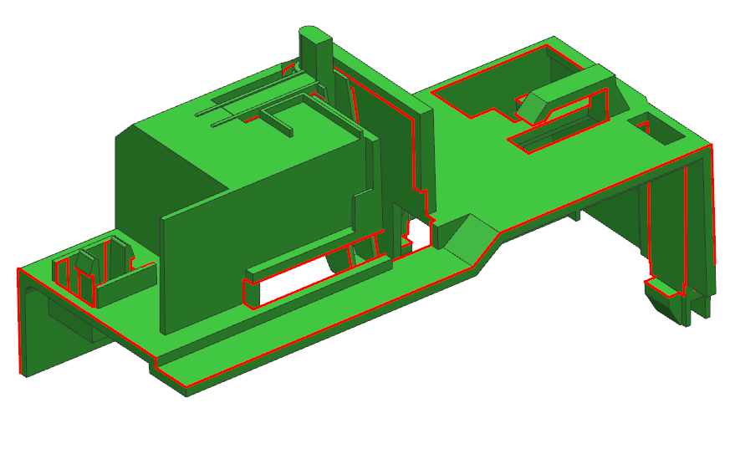
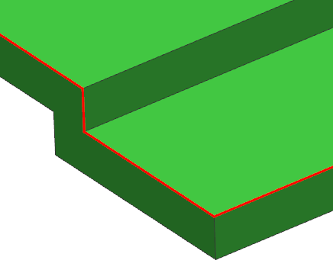
2.Parting Line
CAV
COR
RESULT | OK | NG
APPD
DATE

Slide 5

3.Parting Line
CAV
COR
RESULT | OK | NG
APPD
DATE

Slide 6
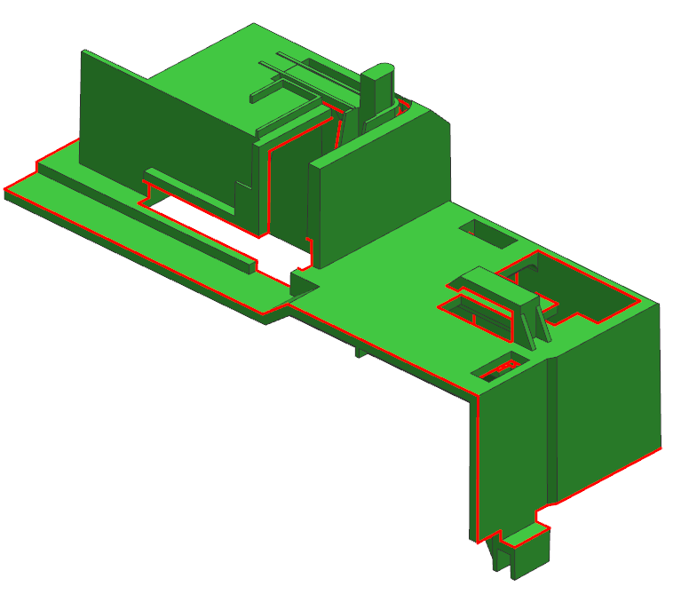
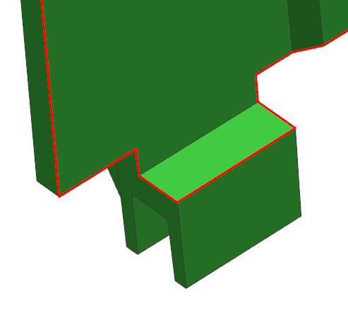
4.Parting Line
CAV
COR
RESULT | OK | NG
APPD
DATE

Slide 7

5.Parting Line
CAV
COR
RESULT | OK | NG
APPD
DATE

Slide 8
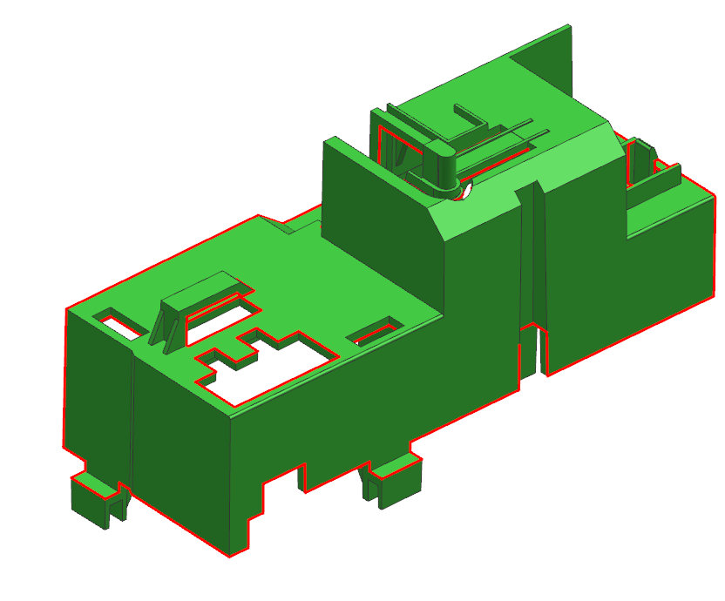

6.Parting Line
CAV
COR
RESULT | OK | NG
APPD
DATE

Slide 9
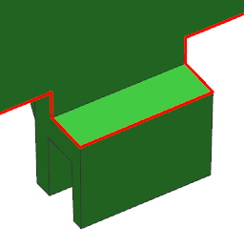
7.Parting Line
CAV
COR
RESULT | OK | NG
APPD
DATE

Slide 10
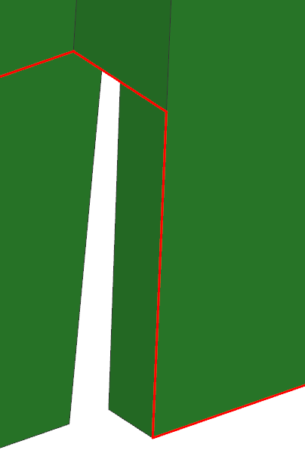
8.Parting Line
CAV
COR
RESULT | OK | NG
APPD
DATE

Slide 11

9.Parting Line
CAV
COR
RESULT | OK | NG
APPD
DATE

Slide 12
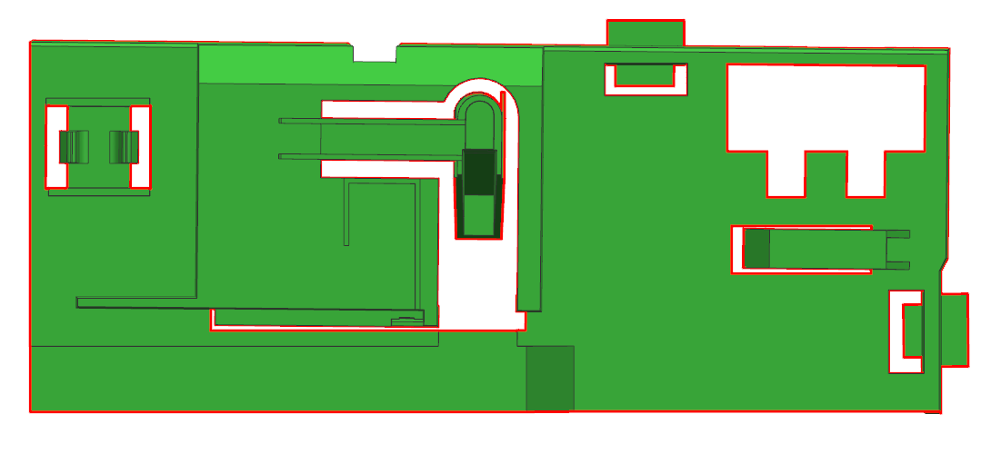

10.Parting Line
CAV
COR
RESULT | OK | NG
APPD
DATE

Slide 13
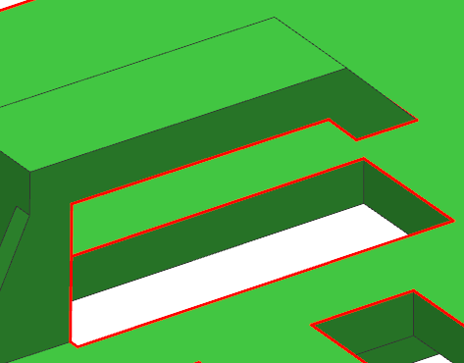
11.Parting Line
CAV
COR
RESULT | OK | NG
APPD
DATE

Slide 14
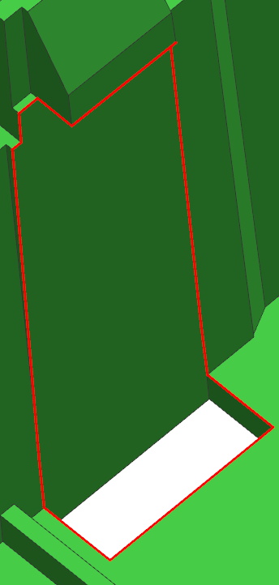
12.Parting Line
CAV
COR
RESULT | OK | NG
APPD
DATE

Slide 15
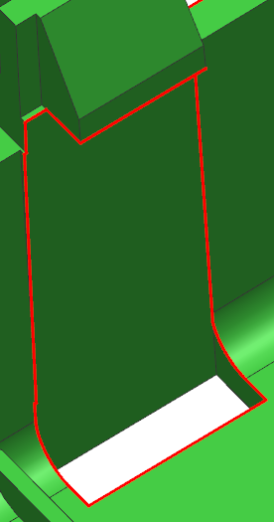
13.Parting Line
CAV
COR
RESULT | OK | NG
APPD
DATE

Slide 16
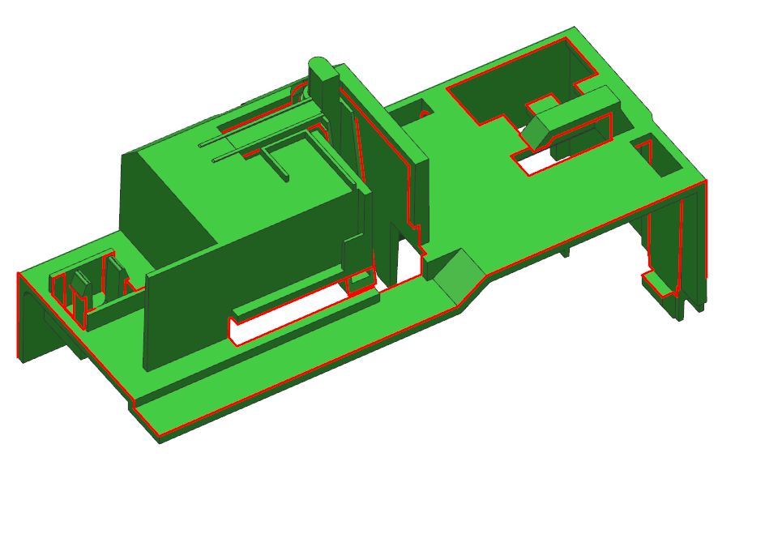
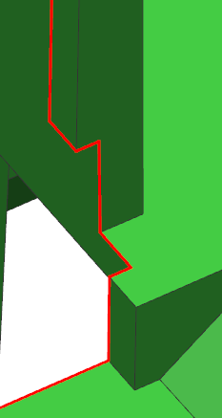
14.Parting Line
CAV
COR
RESULT | OK | NG
APPD
DATE

Slide 17

15.Parting Line
CAV
COR
RESULT | OK | NG
APPD
DATE

Slide 18
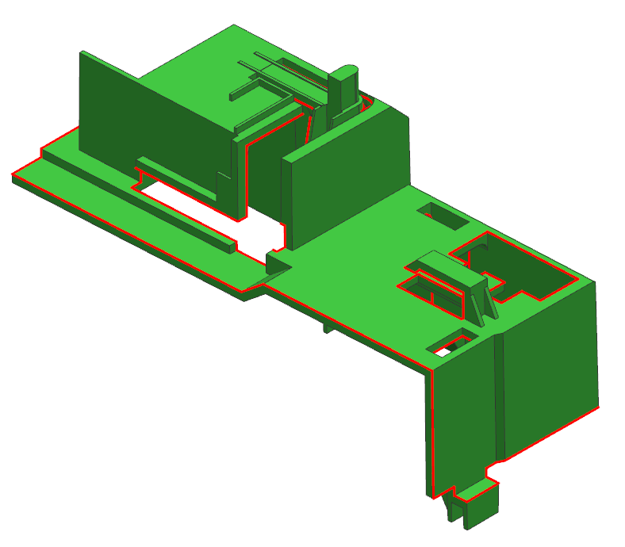
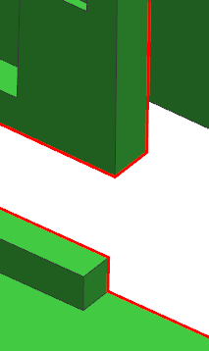
16.Parting Line
CAV
COR
RESULT | OK | NG
APPD
DATE

Slide 19
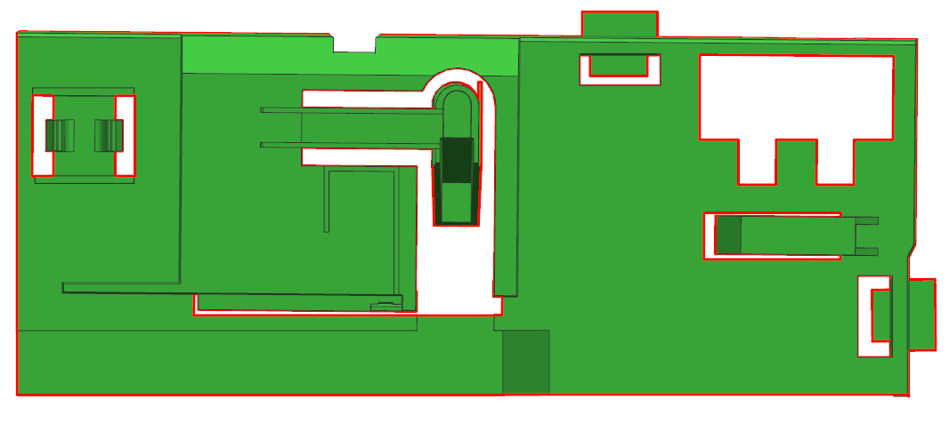

17.Parting Line
CAV
COR
RESULT | OK | NG
APPD
DATE

Slide 20
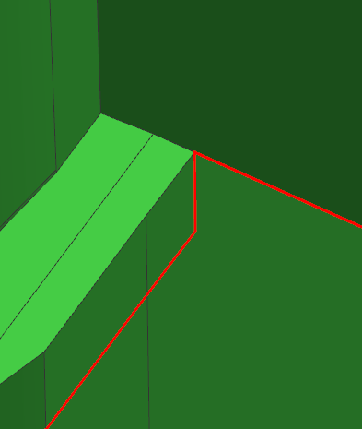
18.Parting Line
CAV
COR
RESULT | OK | NG
APPD
DATE

Slide 21

19.Parting Line
CAV
COR
RESULT | OK | NG
APPD
DATE

Slide 22

20.Parting Line
CAV
COR
RESULT | OK | NG
APPD
DATE

Slide 23
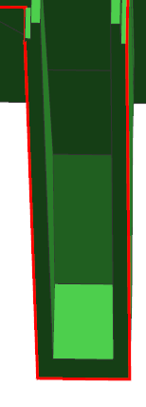
21.Parting Line
CAV
COR
RESULT | OK | NG
APPD
DATE

Slide 24
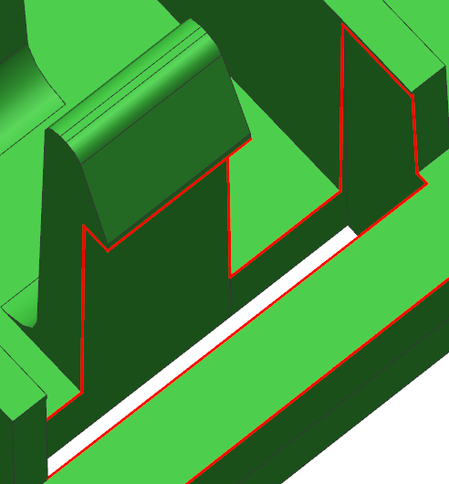
22.Parting Line
CAV
COR
RESULT | OK | NG
APPD
DATE

Slide 25
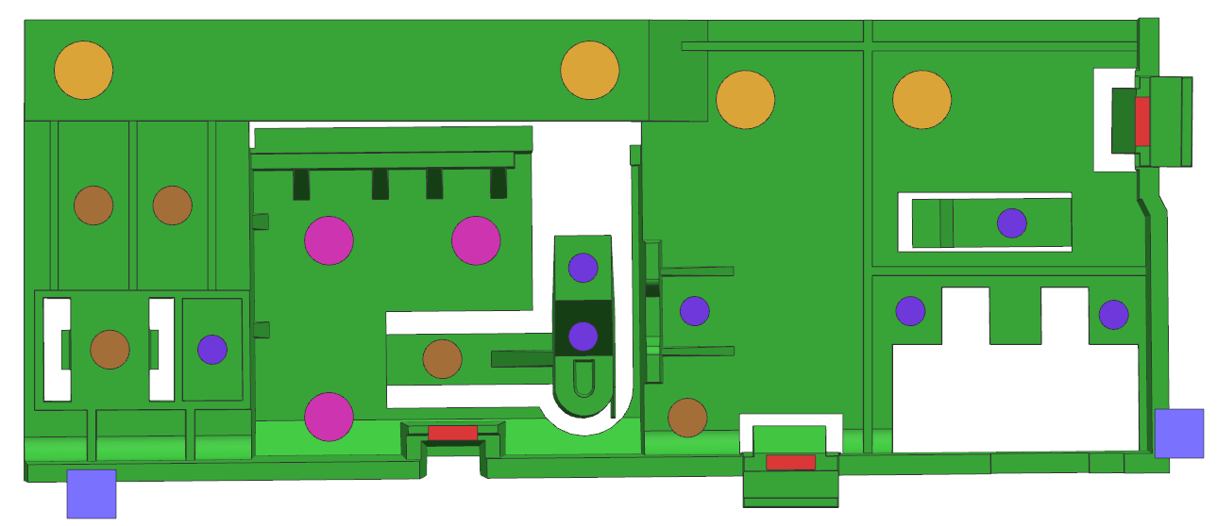






23.Ejector
EP 6.0 ( 4X )
EP 4.0 ( 5X )
EP 5.0 ( 3X )
EP 3.0 ( 7X )
EB 1.5 x 5.0 ( 3X )
RESULT | OK | NG
APPD
DATE
EB 5.0 x 5.0 ( 2X )

Slide 26
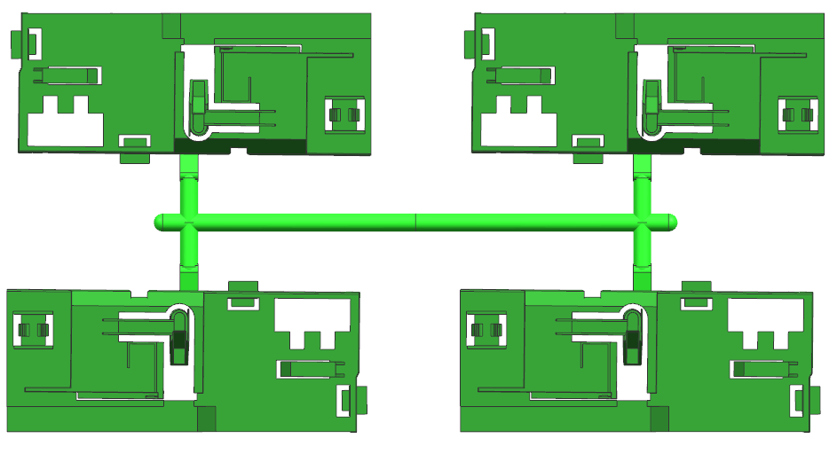
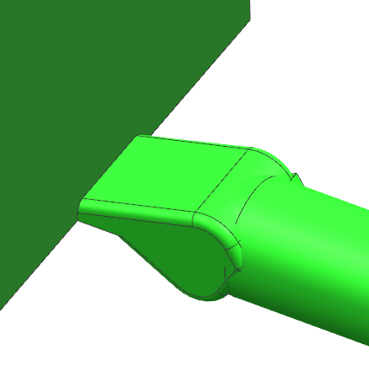
24.Gate
Side Gate
6.0 x 1.0
RESULT | OK | NG
APPD
DATE

Slide 27

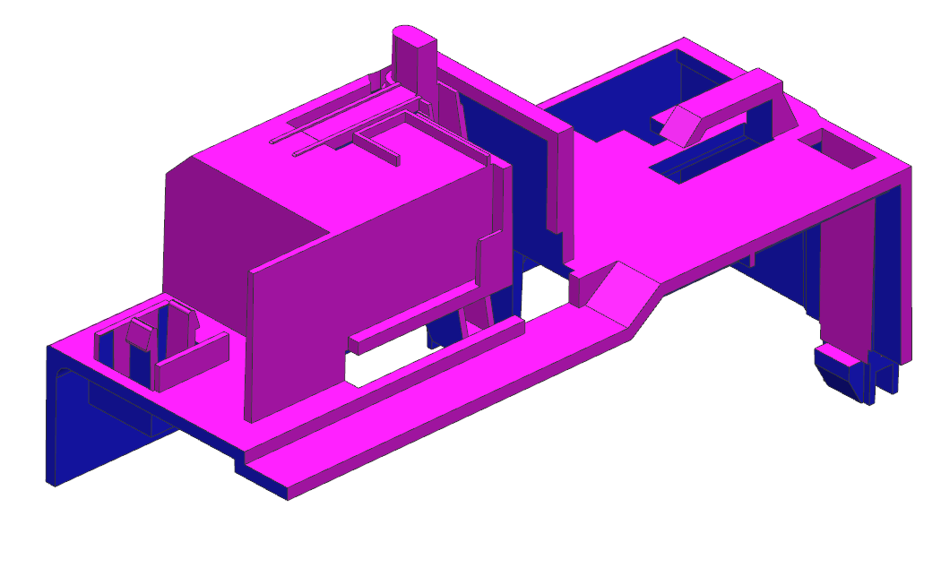
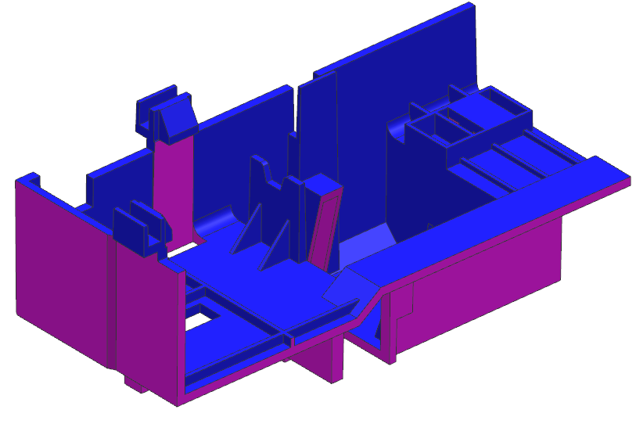
25.Draft angle analysis
RESULT | OK | NG
APPD
DATE
All Green Surface Are 0º Propose To Add 1.0º For Cavity Side &
Draft 0.5º For Core Side

Slide 28
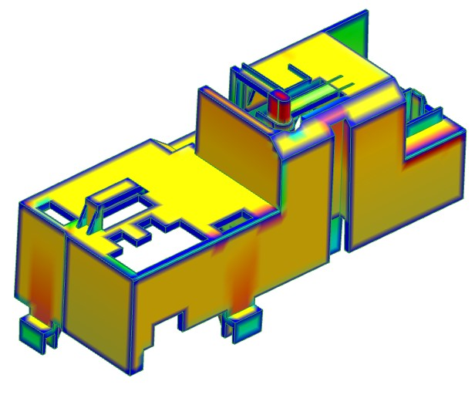
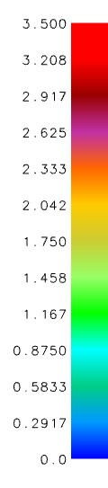
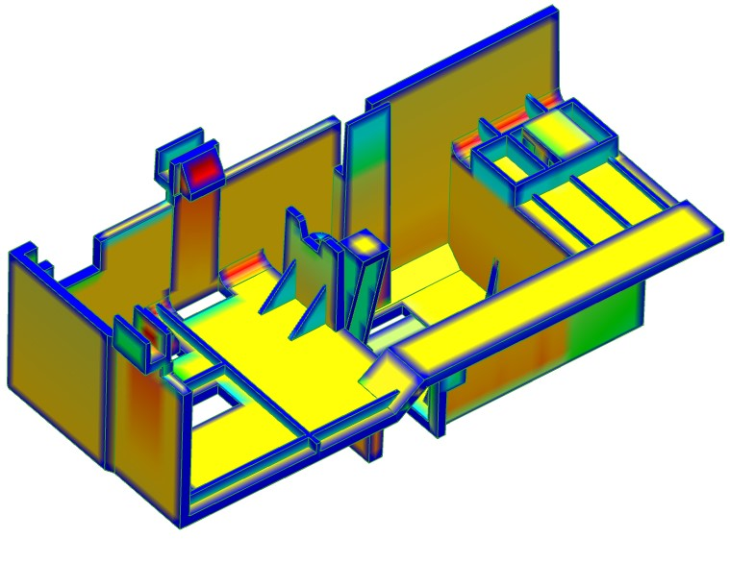
26.Thickness mark
RESULT | OK | NG
APPD
DATE
Red surface have thickness mark

Slide 29
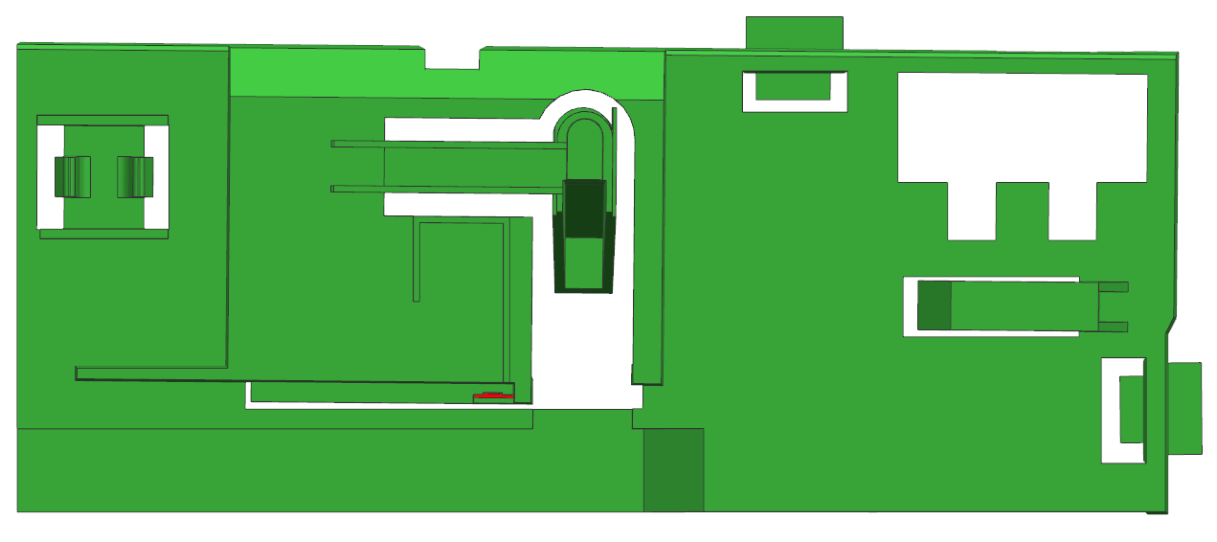
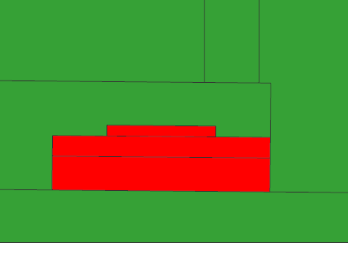
27.Suggest
Suggest to modify part shape because
Weak steel , easy broken
0.8mm
RESULT | OK | NG
APPD
DATE

Slide 30
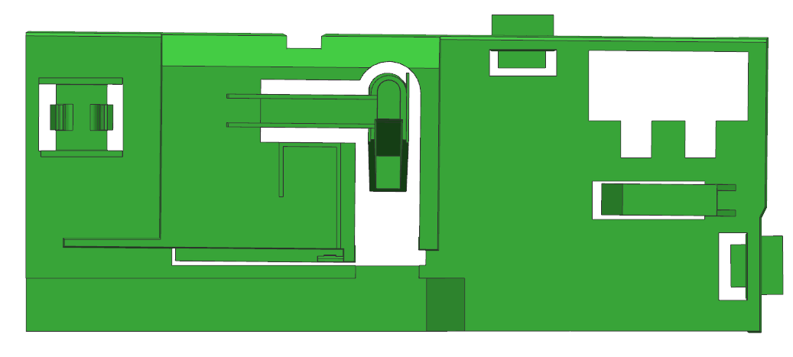
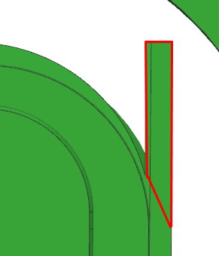
28.Suggest
Suggest to cancel part shape
RESULT | OK | NG
APPD
DATE

Slide 31
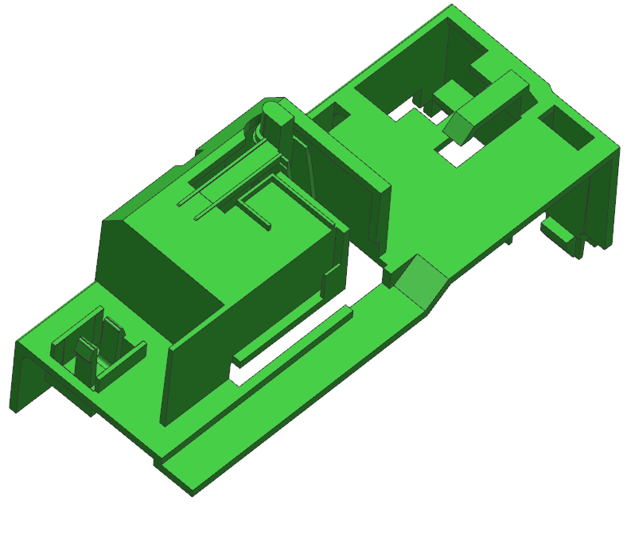
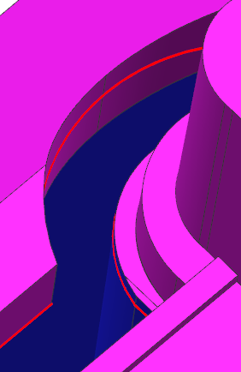
29.Suggest
Undercut， Suggest to add draft 0.5°at core side
RESULT | OK | NG
APPD
DATE
Undercut

Slide 32

30.Suggest
Undercut， Suggest to add draft 1.0°at cavity side
Undercut
RESULT | OK | NG
APPD
DATE

Slide 33

31.Suggest
Undercut， Suggest to add draft 1.0°at cavity side
Undercut
RESULT | OK | NG
APPD
DATE

Slide 34
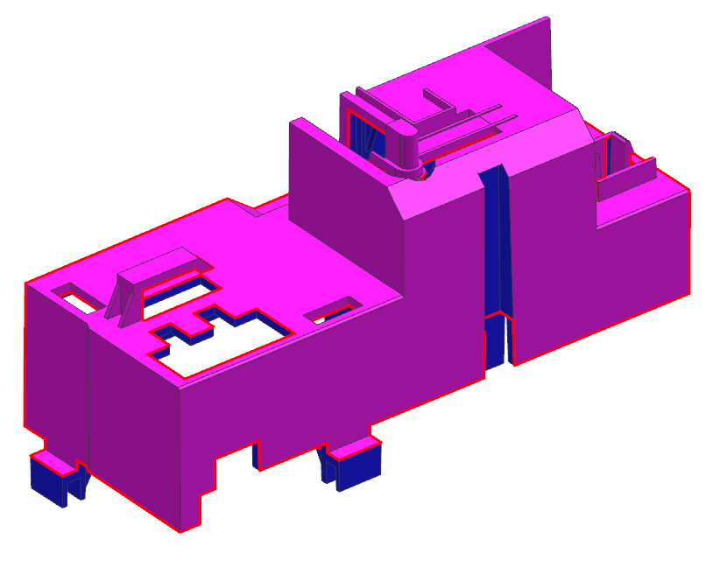
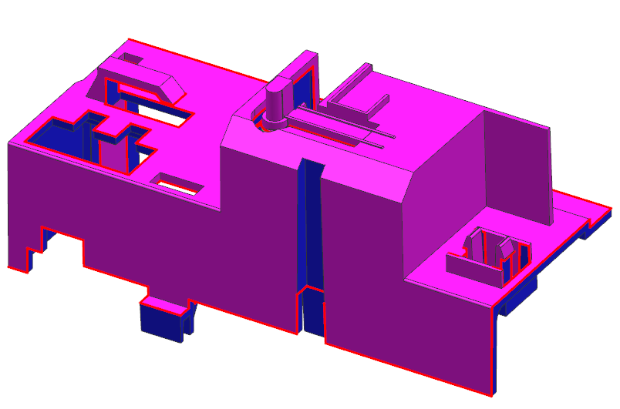
32.Suggest
Undercut
Undercut， Suggest to add draft 1.0°at cavity side
RESULT | OK | NG
APPD
DATE

Slide 35
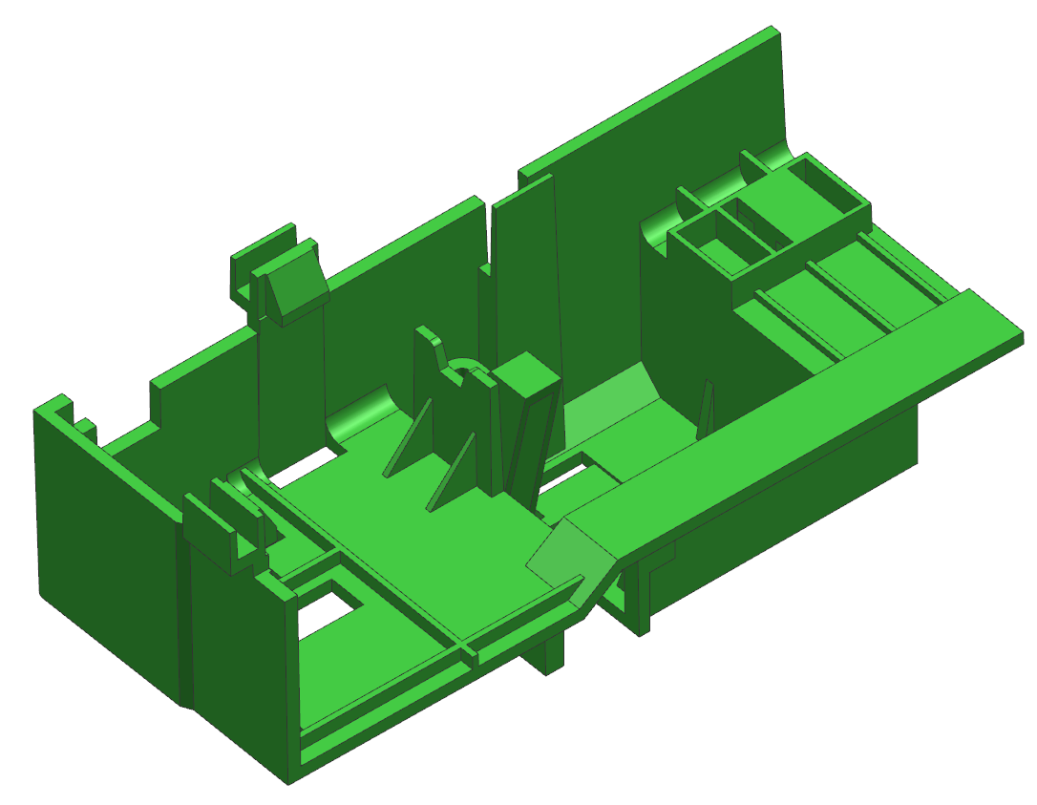

33.Suggest
Undercut， Suggest to cancel undercut and
pl make same level
RESULT | OK | NG
APPD
DATE
Undercut

Slide 36
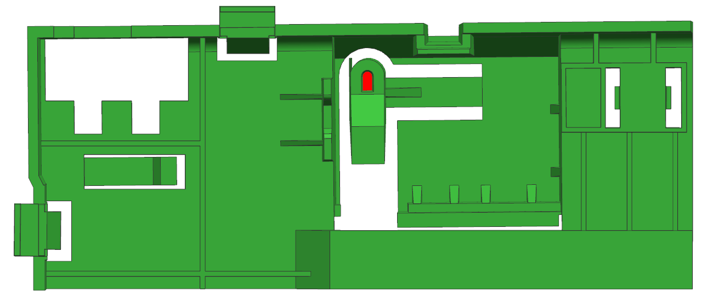
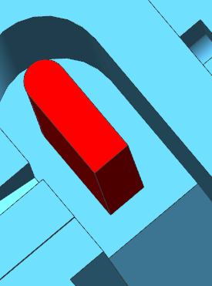
34.Suggest
Suggest to modify part shape
weak steel easy broken
2.0
RESULT | OK | NG
APPD
DATE

Slide 37
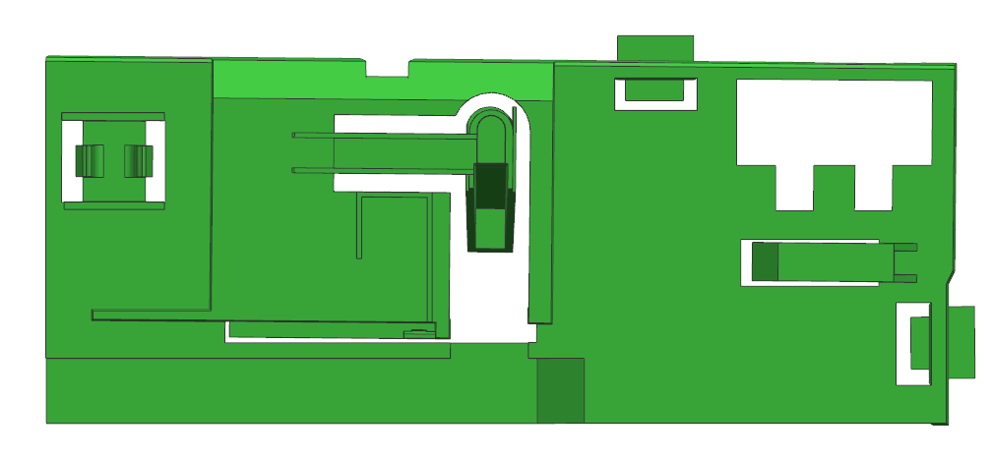
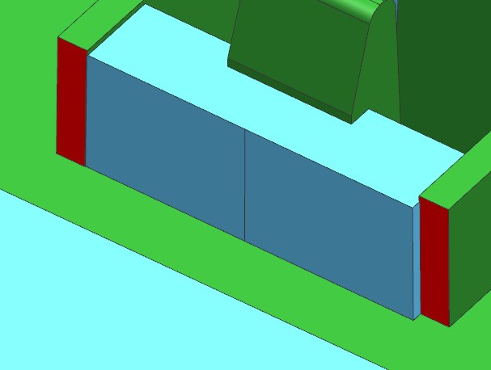
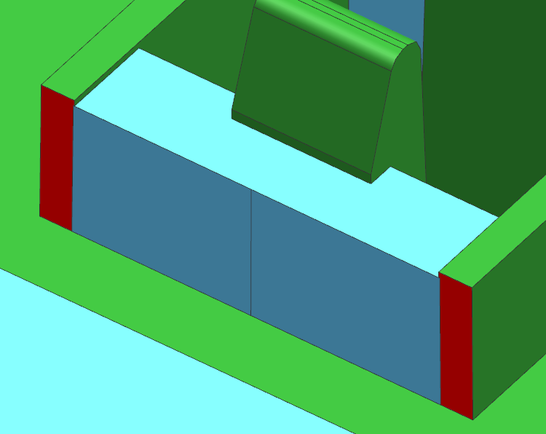
35.Suggest
Suggest to make both face same level
Because undercut to cavity side
RESULT | OK | NG
APPD
DATE
Before
After

Slide 38
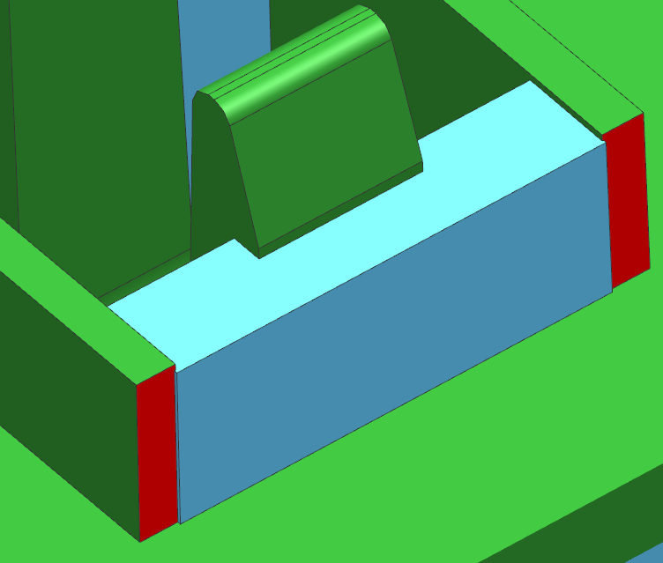
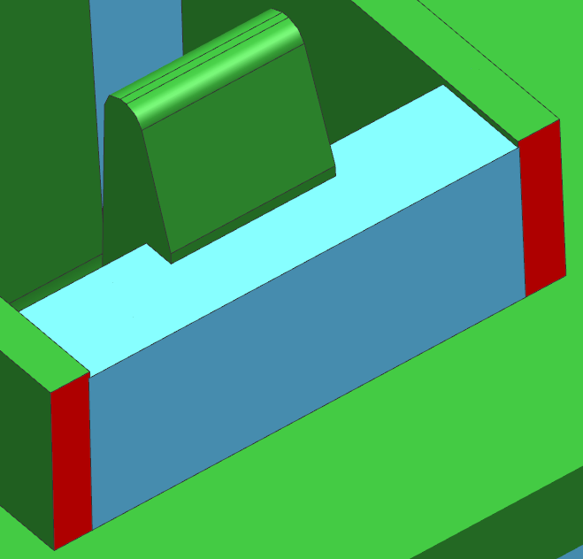
36.Suggest
Suggest to make both face same level
Because undercut to cavity side
RESULT | OK | NG
APPD
DATE
Before
After

Slide 39
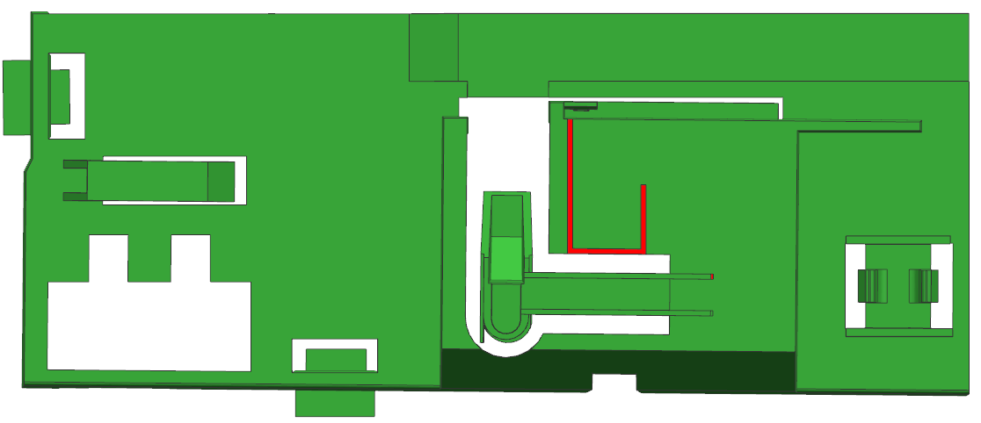
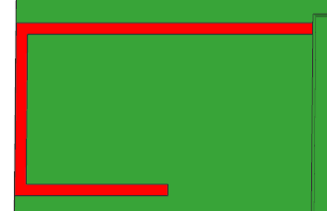
37.Suggest
0.6
RESULT | OK | NG
APPD
DATE
Suggest to change rib dimension
0.6 to 0.8mm because of short shot

Slide 40

38.Mold Layout
500
330
200
400
Mold Top
350
75 TON
RESULT | OK | NG
APPD
DATE
Distance between tie rods (HXV) 375 X 360
Machine size need to change from 75T to 100T

Slide 41

39.Fill Time
RESULT | OK | NG
APPD
DATE
Filling time = 1.884sec

Slide 42


40.Fill Simulation
RESULT | OK | NG
APPD
DATE
(Press shift + F5 to watch animation )

Slide 43

41.Temperature at flow front
RESULT | OK | NG
APPD
DATE

Slide 44

42.Ejection Temperature
RESULT | OK | NG
APPD
DATE

Slide 45

43.Air Traps
RESULT | OK | NG
APPD
DATE
Not serious air traps

Slide 46

44.Weld Lines
RESULT | OK | NG
APPD
DATE
Not serious weld line

Slide 47

45.Cycle Time
1.Fill time = 1.884sec
2.Pack time = 8.0 sec
3.Cooling time = 15.0 sec
4.Mold open time = 5.0 sec
Cycle time = Fill + Pack + Cooling + Mold open
= 29.884 sec
RESULT | OK | NG
APPD
DATE

